Slide 1

Workshop on C/C++
Day 3

Slide 2
Agenda
Recursive Functions
C Libraries
Enum, Structure and Union
File Handling
Logical Programming (Exercises)

Slide 3
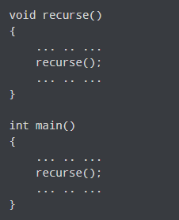
C Recursion
A function that calls itself is known as a recursive function.
How recursion works?

Slide 4
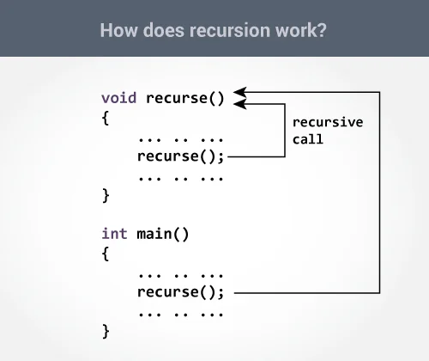
C Recursion
A function that calls itself is known as a recursive function.
How recursion works?

Slide 5
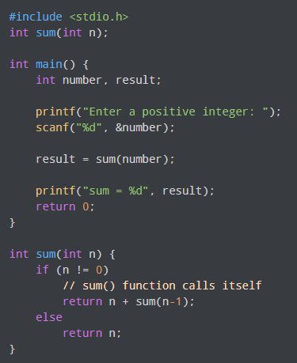
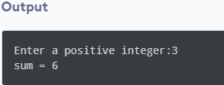
C Recursion
Example: Sum of Natural Numbers Using Recursion

Slide 6
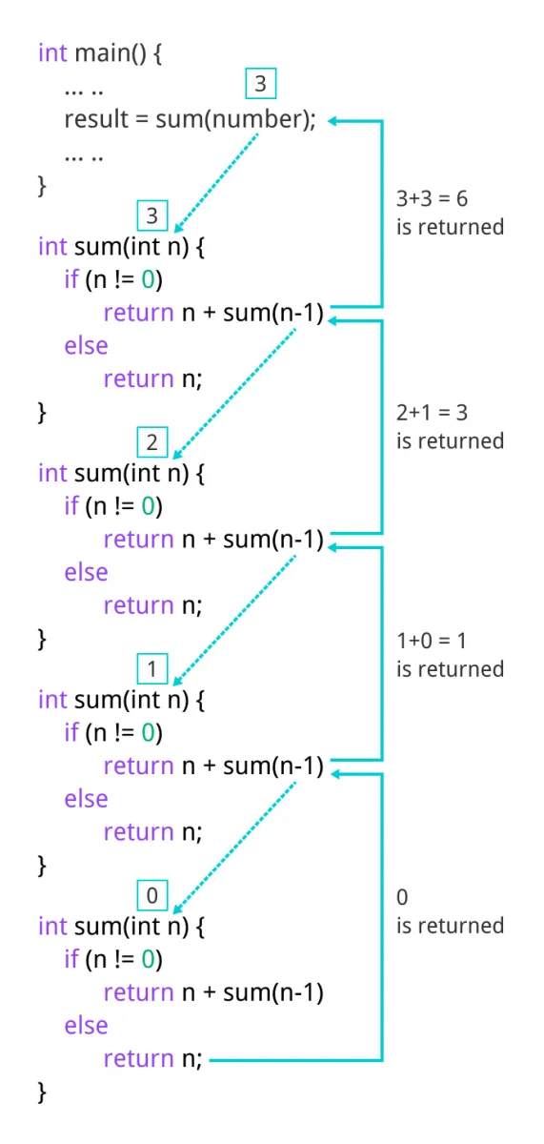
C Recursion

Slide 7
C Storage Class
Every variable in C programming has two properties: type and storage class.
Type refers to the data type of a variable. And,
Storage class determines the scope, visibility and lifetime of a variable.
There are 4 types of storage class:
automatic
external
static
register

Slide 8
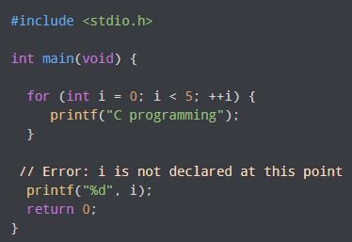
Local Variable
The variables declared inside a block are automatic or local variables.
The local variables exist only inside the block in which it is declared.

Slide 9
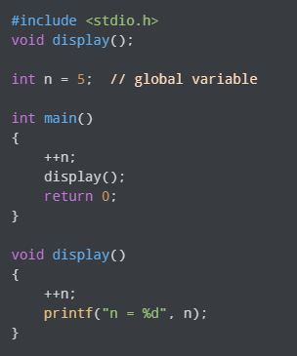
Global Variable
Variables that are declared outside
of all functions are known as external
or global variables.
They are accessible from any function
inside the program.

Slide 10
Register Variable
The register keyword is used to declare register variables.
Register variables were supposed to be faster than local variables.
Unless you are working on embedded systems where you know how to optimize code for the given application, there is no use of register variables.

Slide 11
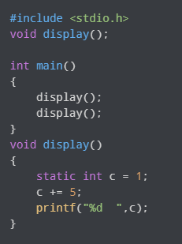
Static Variable
A static variable is declared by
using the static keyword.
For example:
static int i;
The value of a static variable persists
until the end of the program.

Slide 12
C structure
A struct (or structure) is a collection of variables (can be of different types) under a single name.
Define Structure
struct Person {
char name[50];
int citNo;
float salary;
};

Slide 13
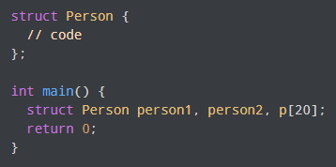

C structure
Create struct Variables
Another way

Slide 14
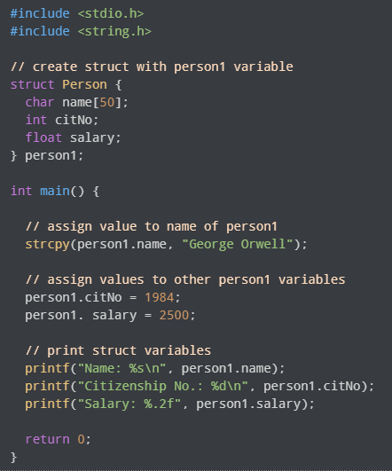
C structure
Access Members of a Structure
There are two types of operators
used for accessing members of
a structure.
. - Member operator
-> - Structure pointer operator

Slide 15
Nested Structures
Example:
struct complex {
int imag;
float real;
};
struct number {
struct complex comp;
int integers;
} num1, num2;

Slide 16
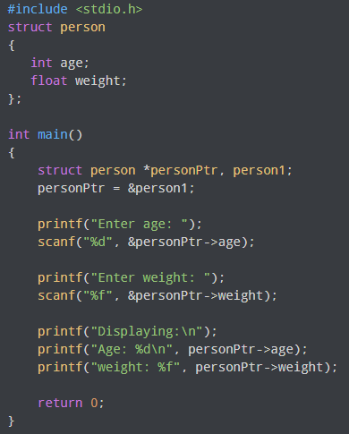
C Pointers to structure
personPtr->age is equivalent to
(*personPtr).age
personPtr->weight is equivalent to
(*personPtr).weight

Slide 17
C Unions
A union is a user-defined type similar to structs in C except for one key difference.
Structures allocate enough space to store all their members, whereas unions can only hold one member value at a time.
How to define a union?
We use the union keyword to define unions.
union car
{
char name[50];
int price;
};

Slide 18
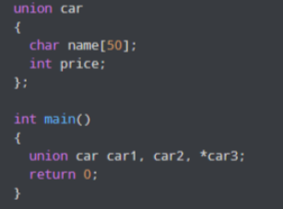
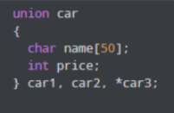
C Unions
Create union variables
Another way

Slide 19
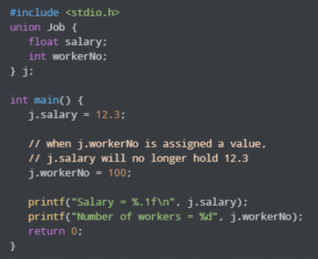
C Unions
Accessing Union Members

Slide 20
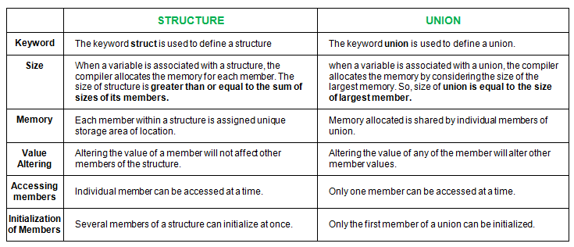
Difference between Structure and Union

Slide 21
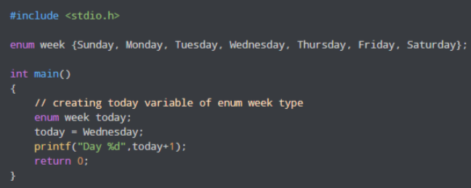
C enums
An enumeration type
(also called enum) is a data type
that consists of integral
constants.
To define enums, the enum
keyword is used.
Example: Enumeration Type

Slide 22
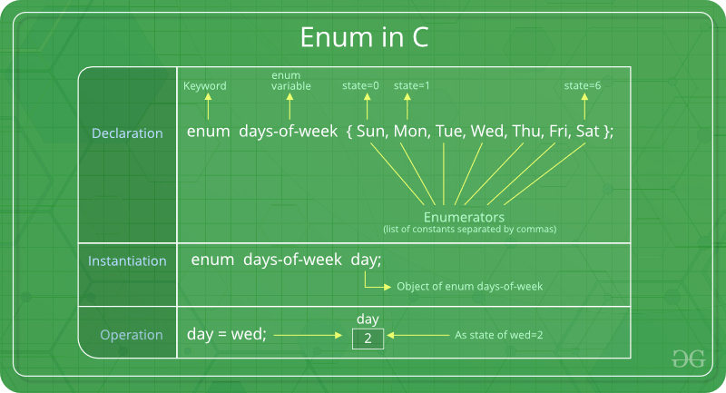
C enum
An enumeration type
(also called enum) is a data type
that consists of integral
constants.
To define enums, the enum
keyword is used.
Example: Enumeration Type

Slide 23
C File Handling
A file is a container in computer storage devices used for storing data.
Why files are needed?
Storing in a file will preserve your data even if the program terminates.
If you have a file containing all the data, you can easily access the contents of the file using a few commands in C.
You can easily move your data from one computer to another without any changes.

Slide 24
C File Handling
Types of Files
There are two types of files:
Text files – Text files are the normal .txt files.
Binary files –Binary files are mostly the .bin files in your computer. Instead of storing data in plain text, they store it in the binary form (0's and 1's).

Slide 25
C File Handling
File Operations
We can perform four major operations on files, either text or binary:
Creating a new file
Opening an existing file
Closing a file
Reading from and writing information to a file

Slide 26
C File Handling
Working with files
When working with files, we need to declare a pointer of type file.
This declaration is needed for communication between the file and the program.
FILE *fptr;

Slide 27
C File Handling
Opening a file - for creation and edit
Opening a file is performed using the fopen() function defined in the stdio.h header file.
The syntax for opening a file in standard I/O is:
ptr = fopen("fileopen","mode");
For example:
fopen("E:\\cprogram\\newprogram.txt","w");
fopen("E:\\cprogram\\oldprogram.bin","rb");

Slide 28
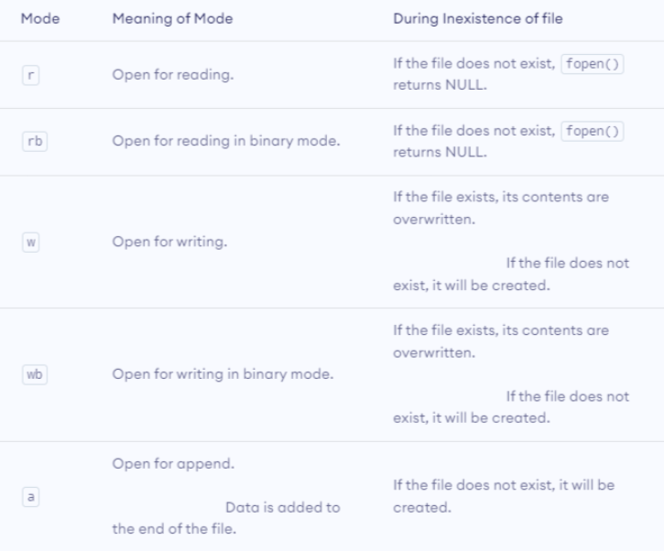
C File Handling
File Opening Modes in Standard I/O

Slide 29
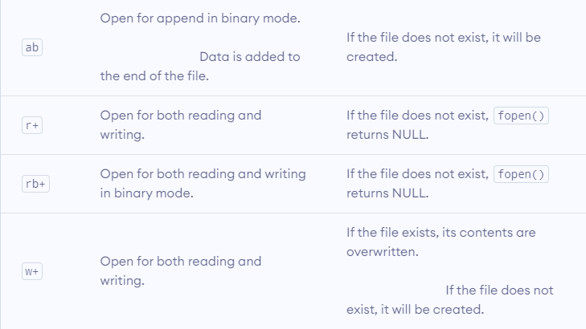
C File Handling
File Opening Modes in Standard I/O

Slide 30
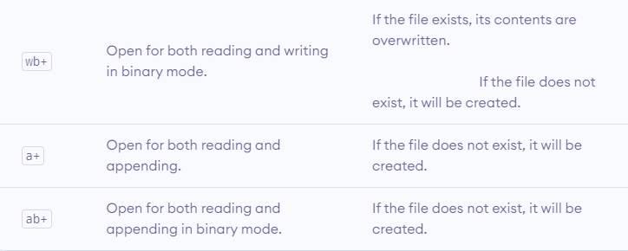
C File Handling
File Opening Modes in Standard I/O

Slide 31
C File Handling
Closing a File
The file (both text and binary) should be closed after reading/writing.
Closing a file is performed using the fclose() function.
fclose(fptr);
Here, fptr is a file pointer associated with the file to be closed.

Slide 32
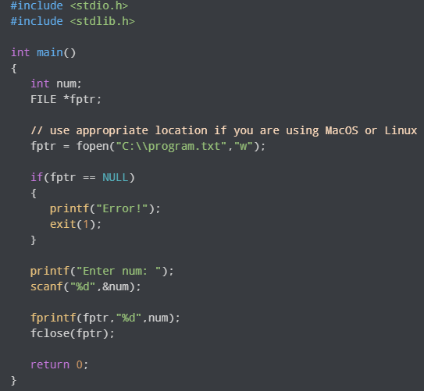
C File Handling
Reading and writing to a text file
For reading and writing to a text
file, we use the functions
fprintf() and fscanf().
fprintf() and fscanf() expects a
pointer to the structure FILE.
Example: Write to a text file

Slide 33
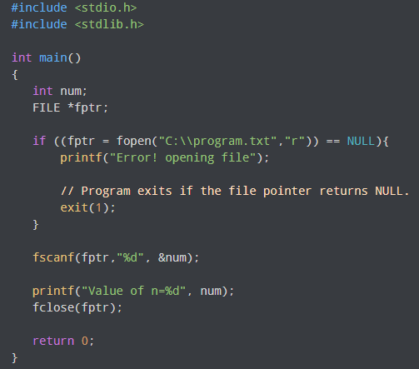
C File Handling
Reading and writing to a text file
Example: Read from a
text file

Slide 34
C File Handling
Getting data using fseek()
If we have many records inside a file and need to access a record at a specific position, we need to loop through all the records before it to get the record.
This will waste a lot of memory and operation time.
An easier way to get to the required data can be achieved using fseek().
fseek() seeks the cursor to the given record in the file.

Slide 35
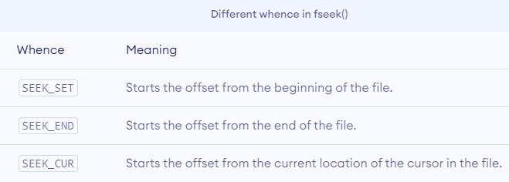
C File Handling
Getting data using fseek()
Syntax of fseek()
fseek(FILE * stream, long int offset, int whence);

Slide 36


Slide 37

Please contact
Foundation for Innovation and Collaborative
Education
mentor@fice.in
www.fice.in
Please contact
Foundation for Innovation and Collaborative
Education
info@fice.in
mentor@fice.in
Notes:
Here are the lessons we are going to learn today.

